Slide 1
Distributed Algorithms
Overview of Distributed Systems
Coulouris, Dollimore and Kindberg
Updated by Tanin and Buyya

Slide 2
A typical portion of the Internet
intranet

ISP



backbone
satellite link
desktop comp
server
network link
Coulouris, Dollimore and Kindberg
Updated by Tanin and Buyya

Slide 3
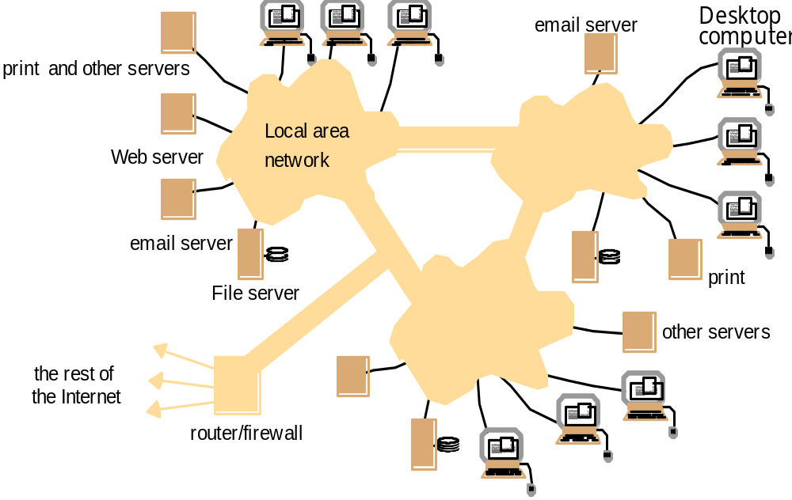
A typical intranet
Coulouris, Dollimore and Kindberg
Updated by Tanin and Buyya

Slide 4
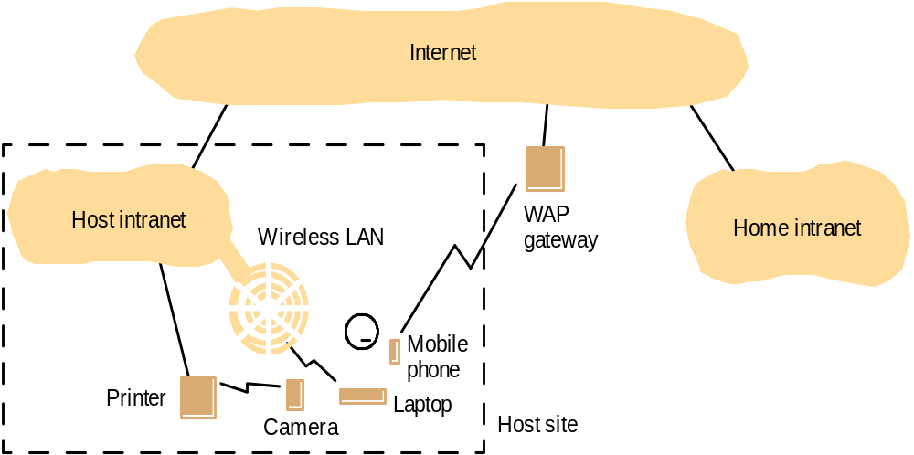
Portable and handheld devices in a distributed system
Coulouris, Dollimore and Kindberg
Updated by Tanin and Buyya

Slide 5
Web servers and web browsers
http://www.google.comlsearch?q=kindberg
www.google.com
Web servers
Browsers
www.cdk3.net
Internet
http://www.cdk3.net/
www.w3c.org
File system of
http://www.w3c.org/Protocols/Activity.html
www.w3c.org
Protocols
Activity.html
Coulouris, Dollimore and Kindberg
Updated by Tanin and Buyya

Slide 6
Computers in the Internet
Date
Computers
Web servers
1979, Dec.
188
0
1989, July
130,000
0
1999, July
56,218,000
5,560,866
2003, Jan.
171,638,297
35,424,956
Coulouris, Dollimore and Kindberg
Updated by Tanin and Buyya

Slide 7
Computers vs. Web servers in the Internet
Date
Computers
Web servers
Percentage
1993, July
1,776,000
130
0.008
1995, July
6,642,000
23,500
0.4
1997, July
19,540,000
1,203,096
6
1999, July
56,218,000
6,598,697
12
2001, July
125,888,197
31,299,592
25
42,298,371
Coulouris, Dollimore and Kindberg
Updated by Tanin and Buyya

Slide 8
Transparencies
Access transparency: enables local and remote resources to be accessed using identical operations.
Location transparency: enables resources to be accessed without knowledge of their physical or network location (for example, which building or IP address).
Concurrency transparency: enables several processes to operate concurrently using shared resources without interference between them.
Replication transparency: enables multiple instances of resources to be used to increase reliability and performance without knowledge of the replicas by users or application programmers.
Failure transparency: enables the concealment of faults, allowing users and application programs to complete their tasks despite the failure of hardware or software components.
Mobility transparency: allows the movement of resources and clients within a system without affecting the operation of users or programs.
Performance transparency: allows the system to be reconfigured to improve performance as loads vary.
Scaling transparency: allows the system and applications to expand in scale without change to the system structure or the application algorithms.
Coulouris, Dollimore and Kindberg
Updated by Tanin and Buyya

Slide 9
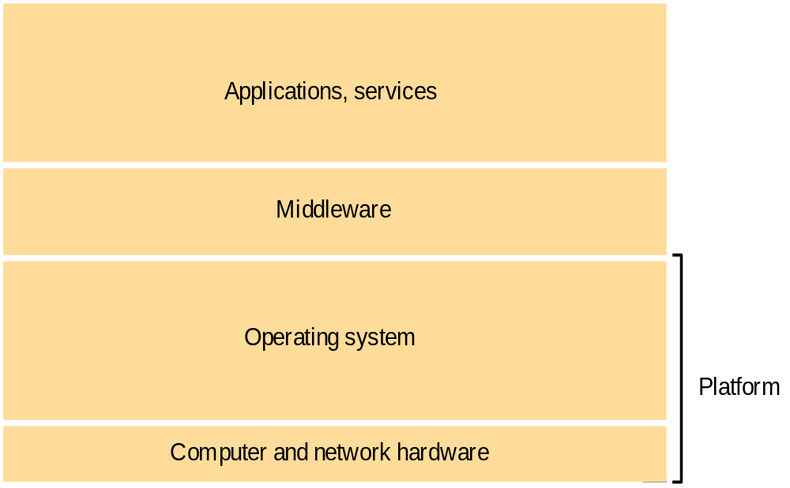
Software and hardware service layers in distributed systems
Coulouris, Dollimore and Kindberg
Updated by Tanin and Buyya

Slide 10
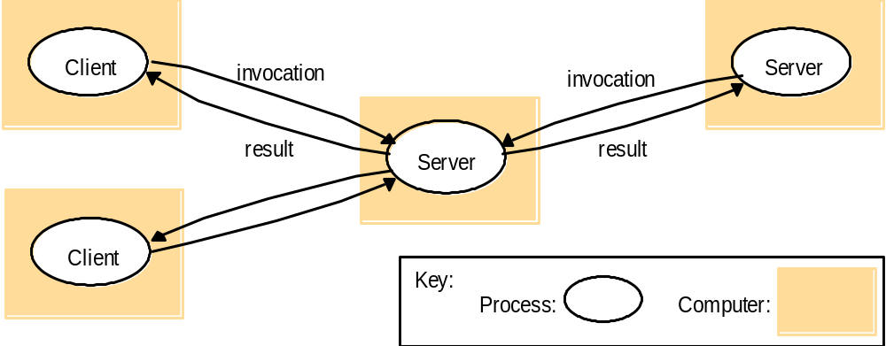
Clients invoke individual servers
Coulouris, Dollimore and Kindberg
Updated by Tanin and Buyya

Slide 11
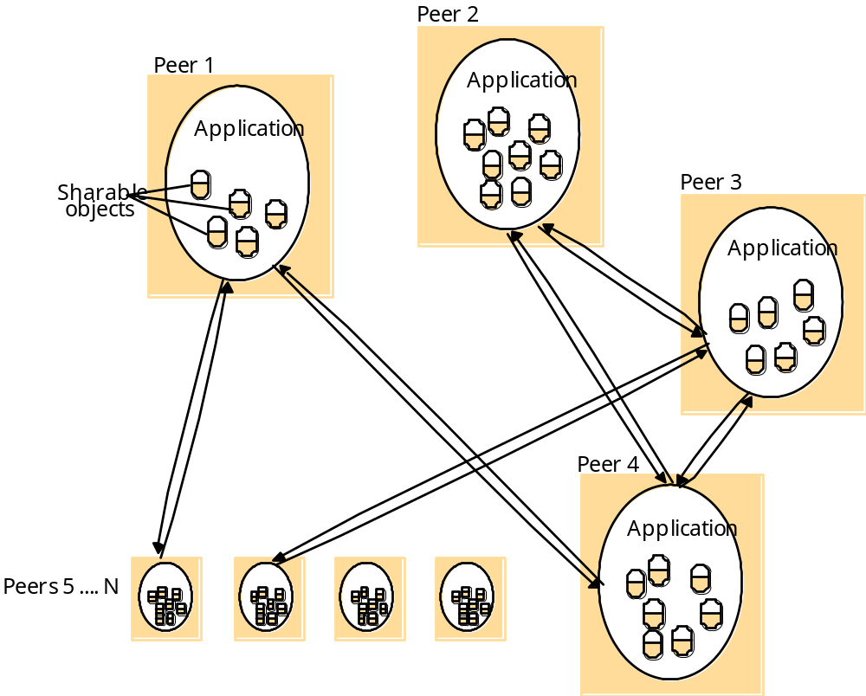
A distributed application based on peer processes
Coulouris, Dollimore and Kindberg
Updated by Tanin and Buyya

Slide 12
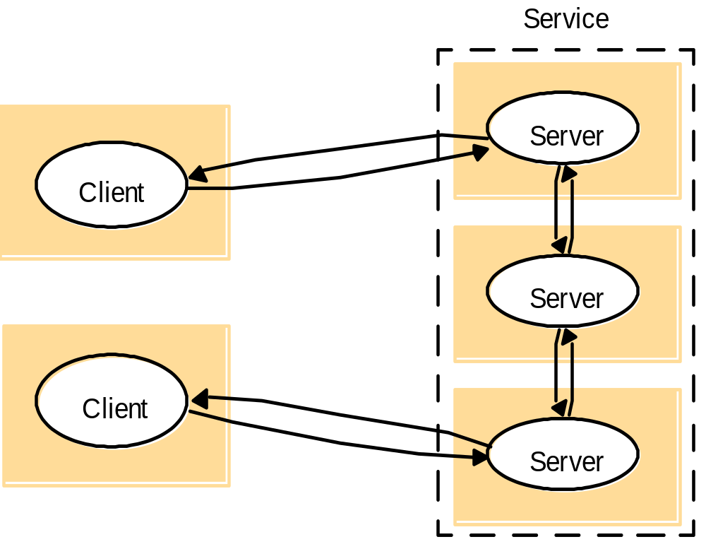
A service provided by multiple servers
Coulouris, Dollimore and Kindberg
Updated by Tanin and Buyya

Slide 13
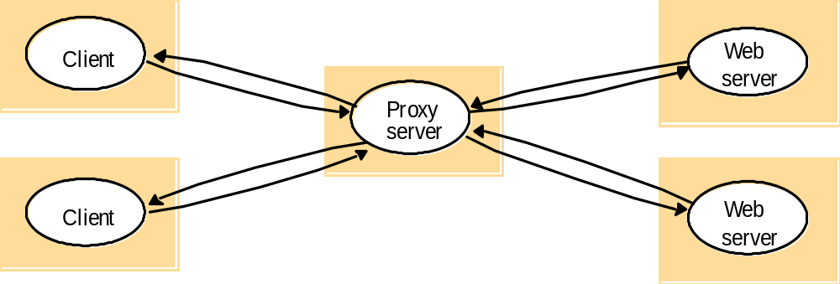
Web proxy server
Coulouris, Dollimore and Kindberg
Updated by Tanin and Buyya

Slide 14
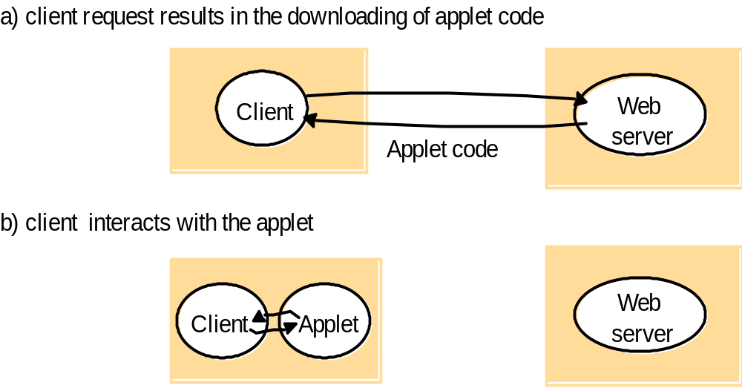
Web applets
Coulouris, Dollimore and Kindberg
Updated by Tanin and Buyya

Slide 15
Thin clients and compute servers
Compute server
Network computer or PC
Thin
network
Application
Client
Process
Coulouris, Dollimore and Kindberg
Updated by Tanin and Buyya

Slide 16
Design Requirements/Challenges of Distributed Systems
Performance Issues
  Responsiveness
  Throughput
  Load balancing and timeliness
Quality of Service:
  Reliability
  Security
  Adaptive performance
Dependability issues:
  Correctness, security, and fault tolerance
  Dependable applications continue to work in the presence of faults in hardware, software, and networks.
Coulouris, Dollimore and Kindberg
Updated by Tanin and Buyya

Slide 17
Event Ordering
In many distributed applications we are interested in knowing whether an event occurred before, after, or concurrently with another event at other processes.
  The execution of a system can be described in terms of events and their ordering despite the lack of accurate clocks.
Consider a mailing list with users X, Y, Z, and A.
Coulouris, Dollimore and Kindberg
Updated by Tanin and Buyya

Slide 18
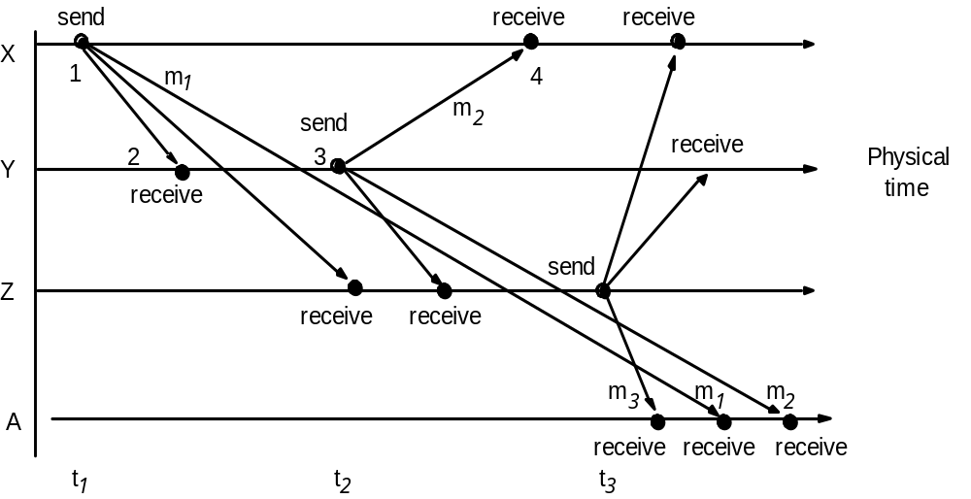
Real-time ordering of events
Coulouris, Dollimore and Kindberg
Updated by Tanin and Buyya

Slide 19
Failures
It is possible to construct reliable services from components that exhibit failures.
  For example, multiple servers that hold replicas of data can continue to provide a service when one of them crashes.
A knowledge of failure characteristics of a component can enable a new service to be designed to mask the failure of the components on which it depends:
  Checksums are used to mask corrupted messages.
Coulouris, Dollimore and Kindberg
Updated by Tanin and Buyya

Slide 20
Security Model
The security of a distributed system can be achieved by securing the processes and the channels used in their interactions and by protecting the objects that they encapsulate against unauthorized access.
Coulouris, Dollimore and Kindberg
Updated by Tanin and Buyya

Slide 21
Network performance
Example
Range
Bandwidth
Latency
(Mbps)
(ms)
Wired:
LAN
Ethernet
1-2 kms
10-1000
1-10
WAN
IP routing
worldwide
0.010-600
100-500
MAN
ATM
250 kms
1-150
10
Internetwork
Internet
worldwide
0.5-600
100-500
Wireless:
WPAN
Bluetooth (802.15.1)
10 - 30m
0.5-2
5-20
WLAN
WiFi (IEEE 802.11)
0.15-1.5 km
2-54
5-20
WMAN
WiMAX (802.16)
550 km
1.5-20
5-20
WWAN
GSM, 3G phone nets
worldwide
0.01-02
100-500
Coulouris, Dollimore and Kindberg
Updated by Tanin and Buyya

Slide 22
Conceptual layering of protocol software
Message sent
Message received
Layer n
Layer 2
Layer 1
Sender
Communication
Recipient
medium
Coulouris, Dollimore and Kindberg
Updated by Tanin and Buyya

Slide 23
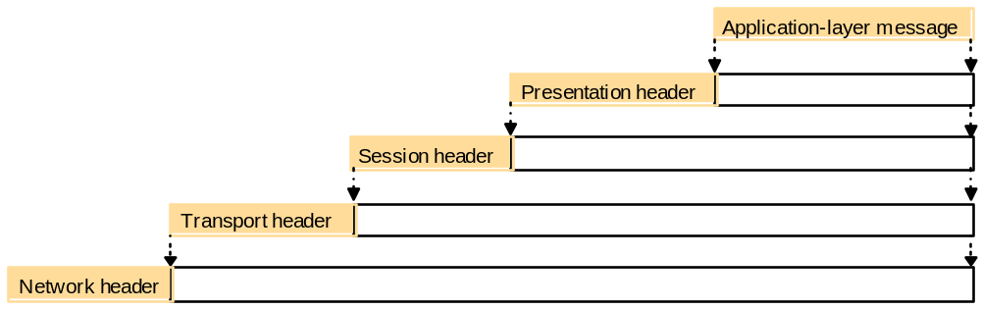
Encapsulation as it is applied in layered protocols
Coulouris, Dollimore and Kindberg
Updated by Tanin and Buyya

Slide 24
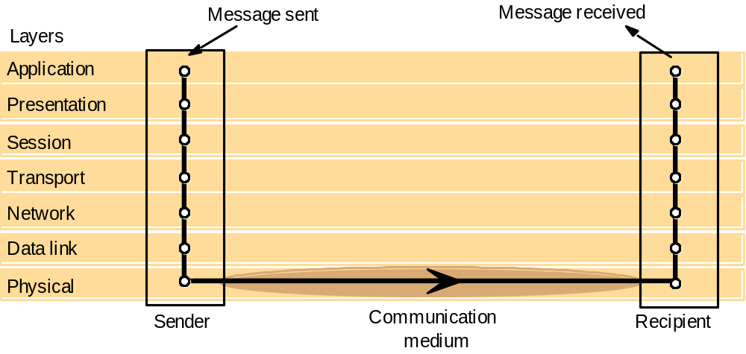
Protocol layers in the ISO Open Systems Interconnection (OSI) model
Coulouris, Dollimore and Kindberg
Updated by Tanin and Buyya

Slide 25
OSI protocol summary
Layer
Description
Examples
Application
Protocols that are designed to meet the communication requirements of
HTTP,
FTP
,
SMTP,
specific applications, often defining the interface to a service.
CORBA IIOP
Presentation
Protocols at this level transmit data in a network representation that is
Secure Sockets
independent of the representations used in individual computers, which may
(
SSL),CORBA Data
differ. Encryption is also performed in this layer, if required.
Rep.
Session
At this level reliability and adaptation are performed, such as detection of
failures and automatic recovery.
Transport
This is the lowest level at which messages (rather than packets) are handled.
TCP,
UDP
Messages are addressed to communication ports attached to processes,
Protocols in this layer may be connection-oriented or connectionless.
Network
Transfers data packets between computers in a specific network. In a WAN
IP,
ATM virtual
or an internetwork this involves the generation of a route passing through
circuits
routers. In a single LAN no routing is required.
Data link
Responsible for transmission of packets between nodes that are directly
Ethernet MAC,
connected by a physical link. In a WAN transmission is between pairs of
ATM cell transfer,
routers or between routers and hosts. In a LAN it is between any pair of hosts.
PPP
Physical
The circuits and hardware that drive the network. It transmits sequences of
Ethernet base- band
binary data by analogue signalling, using amplitude or frequency modulation
signalling,
ISDN
of electrical signals (on cable circuits), light signals (on fibre optic circuits)
or other electromagnetic signals (on radio and microwave circuits).
Coulouris, Dollimore and Kindberg
Updated by Tanin and Buyya

Slide 26
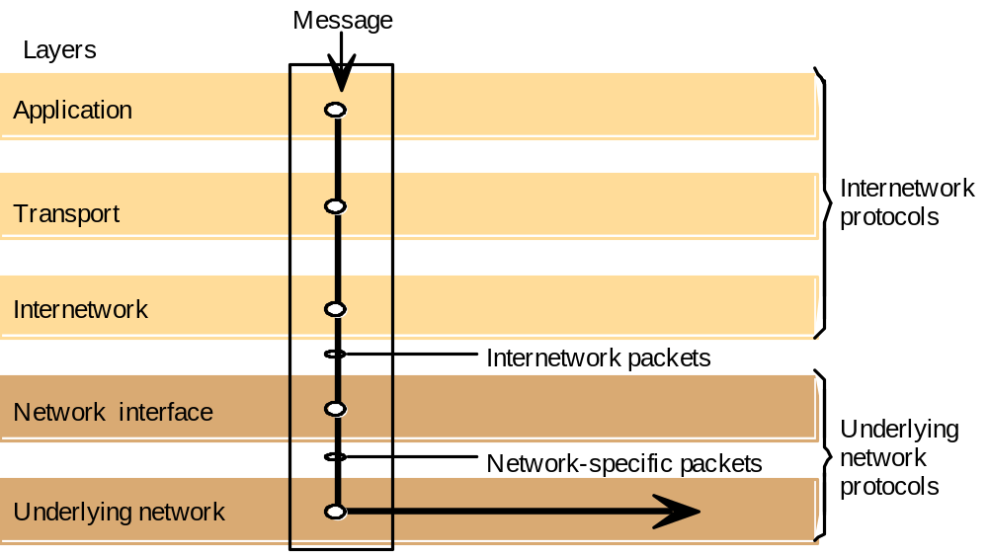
Internetwork layers
Coulouris, Dollimore and Kindberg
Updated by Tanin and Buyya

Slide 27
Routing in a wide area network
A
1
B
Hosts
2
3
Links
4
or local
C
networks
5
D
6
E
Routers
Coulouris, Dollimore and Kindberg
Updated by Tanin and Buyya

Slide 28
TCP/IP layers
Message
Layers
Application
Messages (UDP) or Streams (TCP)
Transport
UDP or TCP packets
Internet
IP datagrams
Network interface
Network-specific frames
Underlying network
Coulouris, Dollimore and Kindberg
Updated by Tanin and Buyya

Slide 29
Encapsulation in a message transmitted via TCP over an Ethernet
Application message
TCP header
port
IP header
TCP
Ethernet header
IP
Ethernet frame
Coulouris, Dollimore and Kindberg
Updated by Tanin and Buyya

Slide 30

The programmer's conceptual view of a TCP/IP Internet
Coulouris, Dollimore and Kindberg
Updated by Tanin and Buyya

Slide 31
IEEE 802 network standards
IEEE No.
Name
Title
Reference
802.3
Ethernet
CSMA/CD Networks (Ethernet)
[IEEE 1985a]
802.4
Token Bus Networks
[IEEE 1985b]
802.5
Token Ring Networks
[IEEE 1985c]
802.6
Metropolitan Area Networks
[IEEE 1994]
802.11
WiFi
Wireless Local Area Networks
[IEEE 1999]
802.15.1
Bluetooth
Wireless Personal Area Networks
[IEEE 2002]
802.15.4
ZigBee
Wireless Sensor Networks
[IEEE 2003]
802.16
WiMAX
Wireless Metropolitan Area Networks
[IEEE 2004a]
Coulouris, Dollimore and Kindberg
Updated by Tanin and Buyya

Slide 32
Ethernet ranges and speeds
10Base5
10BaseT
100BaseT
1000BaseT
Data rate
10 Mbps
10 Mbps
100 Mbps
1000 Mbps
Max. segment lengths:
Twisted wire (UTP)
100 m
100 m
100 m
25 m
Coaxial cable (STP)
500 m
500 m
500 m
25 m
Multi-mode fibre
2000 m
2000 m
500 m
500 m
Mono-mode fibre
25000 m
25000 m
20000 m
2000 m
Coulouris, Dollimore and Kindberg
Updated by Tanin and Buyya

Slide 33
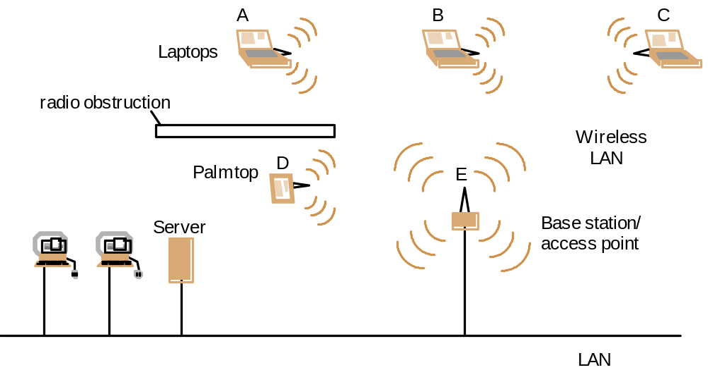
Wireless LAN configuration
Coulouris, Dollimore and Kindberg
Updated by Tanin and Buyya

Slide 34
Sockets
Sockets provide an interface for programming networks at the transport layer.
Network communication using Sockets is very much similar to performing file I/O
  In fact, socket handle is treated like file handle.
  The streams used in file I/O operation are also applicable to socket-based I/O.
Socket-based communication is programming language independent.
  That means, a socket program written in Java language can also communicate to a program written in Java or non-Java socket program.
Coulouris, Dollimore and Kindberg
Updated by Tanin and Buyya

Slide 35
Sockets and ports
any port
agreed port
socket
socket
message
client
server
other ports
Internet address = 138.37.94.248
Internet address = 138.37.88.249

Slide 36
TCP server makes a connection for each client and then echoes the client’s request
import java.net.*;
import java.io.*;
public class TCPServer {
public static void main (String args[]) {
try{
int serverPort = 7896;
ServerSocket listenSocket = new ServerSocket(serverPort);
while(true) {
Socket clientSocket = listenSocket.accept();
Connection c = new Connection(clientSocket);
}
} catch(IOException e) {System.out.println("Listen :"+e.getMessage());}
}
}
// this figure continues on the next slide

Slide 37
Contd
class Connection extends Thread {
DataInputStream in;
DataOutputStream out;
Socket clientSocket;
public Connection (Socket aClientSocket) {
try {
clientSocket = aClientSocket;
in = new DataInputStream( clientSocket.getInputStream());
out =new DataOutputStream( clientSocket.getOutputStream());
this.start();
} catch(IOException e) {System.out.println("Connection:"+e.getMessage());}
}
public void run(){
try { // an echo server
String data = in.readUTF();
out.writeUTF(data);
} catch(EOFException e) {System.out.println("EOF:"+e.getMessage());
} catch(IOException e) {System.out.println("IO:"+e.getMessage());}
} finally{ try {clientSocket.close();}catch (IOException e){/*close failed*/}}
}
}

Slide 38
A simple client that reads from a server
import java.net.*;
import java.io.*;
public class SimpleClient {
public static void main(String args[]) throws IOException {
// Open your connection to a server, at port 1234
Socket s1 = new Socket("mundroo.cs.mu.oz.au",1234);
// Get an input file handle from the socket and read the input
InputStream s1In = s1.getInputStream();
DataInputStream dis = new DataInputStream(s1In);
String st = new String (dis.readUTF());
System.out.println(st);
// When done, just close the connection and exit
dis.close();
s1In.close();
s1.close();
}
}

Slide 39
Middleware layers
Applications
RMI, RPC and events
Middleware
Request reply protocol
layers
External data representation
Operating System
Coulouris, Dollimore and Kindberg
Updated by Tanin and Buyya

Slide 40
Remote and local method invocations
remote
local
C
invocation
invocation
local
E
invocation
remote
B
invocation
F
A
local
invocation
D
Coulouris, Dollimore and Kindberg
Updated by Tanin and Buyya

Slide 41
Role of client and server stub procedures in RPC in the context of a procedural language
client process
server process
Request
Reply
client stub
server stub
procedure
procedure
client
service
program
Communication
Communication
procedure
module
module
dispatcher
Coulouris, Dollimore and Kindberg
Updated by Tanin and Buyya

Slide 42
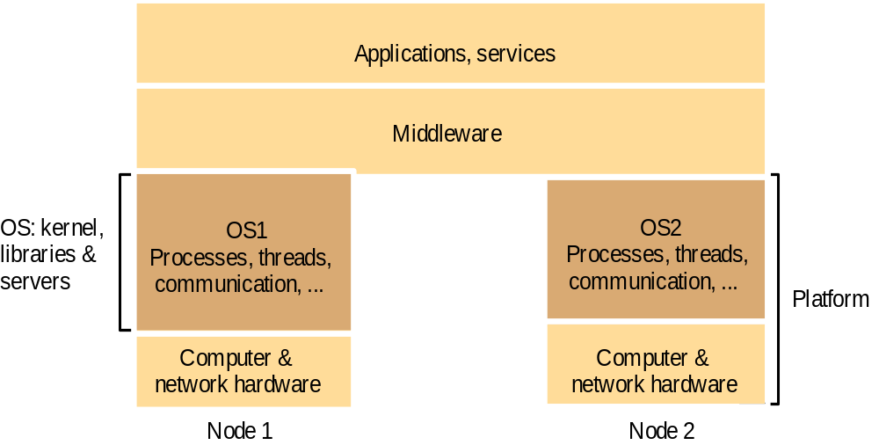
System layers
Coulouris, Dollimore and Kindberg
Updated by Tanin and Buyya

Slide 43
Three threads example
class A extends Thread
{
public void run()
{
for(int i=1;i<=5;i++)
{
System.out.println("\t From ThreadA: i= "+i);
}
System.out.println("Exit from A");
}
}
class B extends Thread
{
public void run()
{
for(int j=1;j<=5;j++)
{
System.out.println("\t From ThreadB: j= "+j);
}
System.out.println("Exit from B");
}
}
Coulouris, Dollimore and Kindberg
Updated by Tanin and Buyya

Slide 44
Contd
class C extends Thread
{
public void run()
{
for(int k=1;k<=5;k++)
{
System.out.println("\t From ThreadC: k= "+k);
}
System.out.println("Exit from C");
}
}
class ThreadTest
{
public static void main(String args[])
{
new A().start();
new B().start();
new C().start();
}
}
Coulouris, Dollimore and Kindberg
Updated by Tanin and Buyya

Slide 45
Run 1
> java ThreadTest
From ThreadA: i= 1
From ThreadA: i= 2
From ThreadA: i= 3
From ThreadA: i= 4
From ThreadA: i= 5
Exit from A
From ThreadC: k= 1
From ThreadC: k= 2
From ThreadC: k= 3
From ThreadC: k= 4
From ThreadC: k= 5
Exit from C
From ThreadB: j= 1
From ThreadB: j= 2
From ThreadB: j= 3
From ThreadB: j= 4
From ThreadB: j= 5
Exit from B
Coulouris, Dollimore and Kindberg
Updated by Tanin and Buyya

Slide 46
Run2
> java ThreadTest
From ThreadA: i= 1
From ThreadA: i= 2
From ThreadA: i= 3
From ThreadA: i= 4
From ThreadA: i= 5
From ThreadC: k= 1
From ThreadC: k= 2
From ThreadC: k= 3
From ThreadC: k= 4
From ThreadC: k= 5
Exit from C
From ThreadB: j= 1
From ThreadB: j= 2
From ThreadB: j= 3
From ThreadB: j= 4
From ThreadB: j= 5
Exit from B
Exit from A
Coulouris, Dollimore and Kindberg
Updated by Tanin and Buyya

Slide 47
Java thread constructor and management methods
Thread(ThreadGroup group, Runnable target, String name)
Creates a new thread in the SUSPENDED state, which will belong to group and be identified as name; the thread will execute the run() method of target.
setPriority(int newPriority), getPriority()
Set and return the thread’s priority.
run()
A thread executes the run() method of its target object, if it has one, and otherwise its own run() method (Thread implements Runnable).
start()
Change the state of the thread from SUSPENDED to RUNNABLE.
sleep(int millisecs)
Cause the thread to enter the SUSPENDED state for the specified time.
yield()
Enter the READY state and invoke the scheduler.
destroy()
Destroy the thread.
Coulouris, Dollimore and Kindberg
Updated by Tanin and Buyya

Slide 48
Java thread synchronization calls
thread.join(int millisecs)
Blocks the calling thread for up to the specified time until thread has terminated.
thread.interrupt()
Interrupts thread: causes it to return from a blocking method call such as sleep().
object.wait(long millisecs, int nanosecs)
Blocks the calling thread until a call made to notify() or notifyAll() on object wakes the thread, or the thread is interrupted, or the specified time has elapsed.
object.notify(), object.notifyAll()
Wakes, respectively, one or all of any threads that have called wait() on object.
Coulouris, Dollimore and Kindberg
Updated by Tanin and Buyya

Slide 49
Shared Resources
If one thread tries to read the data and other thread tries to update the same date, it leads to inconsistent state.
This can be prevented by synchronising access by using for example “Synchronized” method in Java:
  public synchronized void update()
  {
    …
  }
Coulouris, Dollimore and Kindberg
Updated by Tanin and Buyya

Slide 50
Three Threads sharing the same object
class InternetBankingSystem {
public static void main(String [] args ) {
Account accountObject = new Account ();
Thread t1 = new Thread(new MyThread(accountObject));
Thread t2 = new Thread(new YourThread(accountObject));
Thread t3 = new Thread(new HerThread(accountObject));
t1.start();
t2.start();
t3.start();
// DO some other operation
}

Slide 51
Sharing the account object
class MyThread implements Runnable {
…
public MyThread (Account s) { account = s;}
public void run() { account.deposit(); }
} // end class MyThread
class YourThread implements Runnable {
…
public YourThread (Account s) { account = s;}
public void run() { account.withdraw(); }
} // end class YourThread
class HerThread implements Runnable {
…
public HerThread (Account s) { account = s; }
public void run() {account.enquire(); }
} // end class HerThread

Slide 52
Serializing the operation on shared a object
class Account {
int balance;
  // if 'synchronized' is removed, the outcome is unpredictable
  public synchronized void deposit( ) {
  // METHOD BODY : balance += deposit_amount;
  }
  public synchronized void withdraw( ) {
  // METHOD BODY: balance -= deposit_amount;
  }
  public synchronized void enquire( ) {
  // METHOD BODY: display balance.
  }
}

